Slide 1
Automated Contextual Spam Categorization Tool
GROUP 15
LAKHANI, Harsh Sunil
(20910249)
LI, Ka Ho
(20922151)
TSANG, Kai Ho
(20905476)

Slide 2
Contents
Introduction
Clustering
Data
Label Generation
Classification
Demo
01
04
02
05
03
06

Slide 3

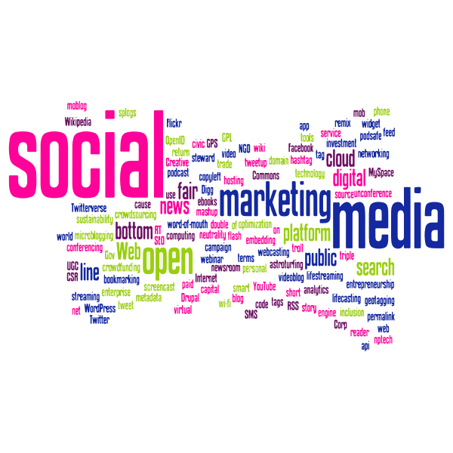

01
Introduction

Slide 4
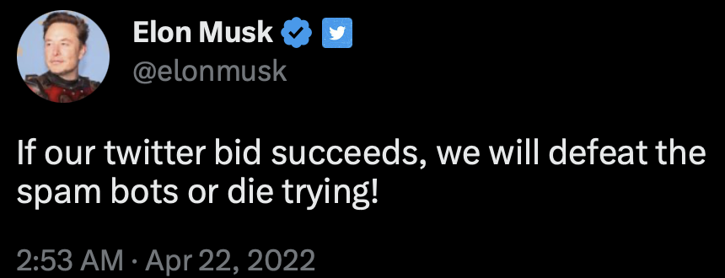
Purpose
Inspiration:
Elon Musk raised concerns about spam content being prevalent throughout social media
Spam content can often be scams that pose a significant risk to unsuspecting individuals
Goal:
Build an automated spam categorization tool to:
Improve content moderation
Provide a cleaner online environment for users
Protect individuals from the harmful consequences of potential scams

Slide 5
Pipeline Workflow
Data Preprocessing
Classification (BERT & RoBERTa)
Clustering (K-means, DBSCAN, Hierarchical)
Label Generation (GPT2 & GPT3.5)

Slide 6
02
Data

Slide 7
Data Sources
Links to datasets
SMS Spam Collection | SMS
Filtering mobile phone spam | SMS
Text Spam Dataset | SMS
Email Spam Dataset | Email
Spam Mails Dataset | Email
Email Spam Dataset (Extended) | Email
Spam Classification for Basic NLP | Email
YouTube Spam Comments | Social Media
Initially attempted to perform classification on ‘YouTube’ comments dataset
Decided to train on SMS/Email spam datasets
SMS/Email Spam vs Ham imbalanced
Curated dataset from different sources, including 3 SMS spam and 4 email spam datasets

Slide 8
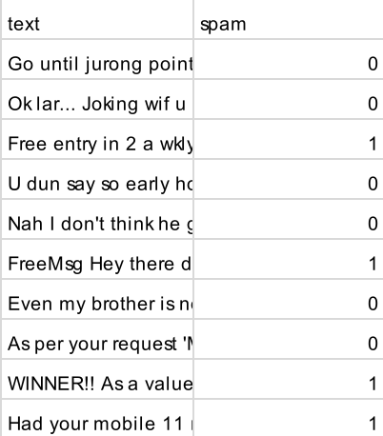
Dataset Sample
Sample snapshot
Distribution of classes
 | Count
Spam | 3000
Ham | 3000

Slide 9
Data Cleaning
Original: <h1> Yo Whats’up? You won the prize! Contact winning@google.com ! </h1>
Remove Links/Address → <h1> Yo Whats’up? You won the prize! Contact winning@google.com ! </h1>
Lowercase → <h1> Yo Whats’up? You won the prize! Contact ! </h1>
Remove HTML Tags → <h1> yo whats’up? you won the prize! contact ! </h1> Remove Punctuation → yo whats’up? you won the prize! contact !
Remove Stop Words → yo whatsup you won the prize contact
*Also performed other preprocessing methods including: remove non ascii characters, special characters, etc.

Slide 10


Classification
03
Notes:
Aaron

Slide 11
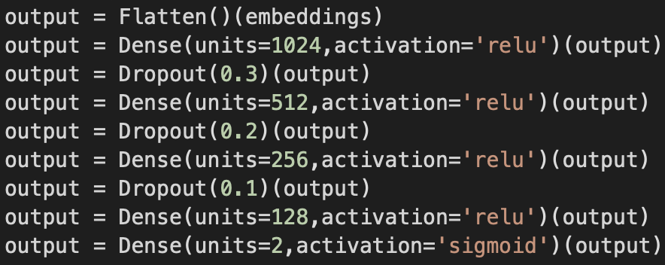
BERT
BERT
(Base)
Model: 'bert-base-uncased'
Number of labels: 2 (spam/ham)
Tokenizer: 'bert-base-uncased'
BERT
(Fine-tuned)

Slide 12
RoBERTa
RoBERTa
(Base)
Model: 'roberta-base’
Number of labels: 2 (spam/ham)
Tokenizer: 'roberta-base'
RoBERTa
(Fine-tuned)

Slide 13
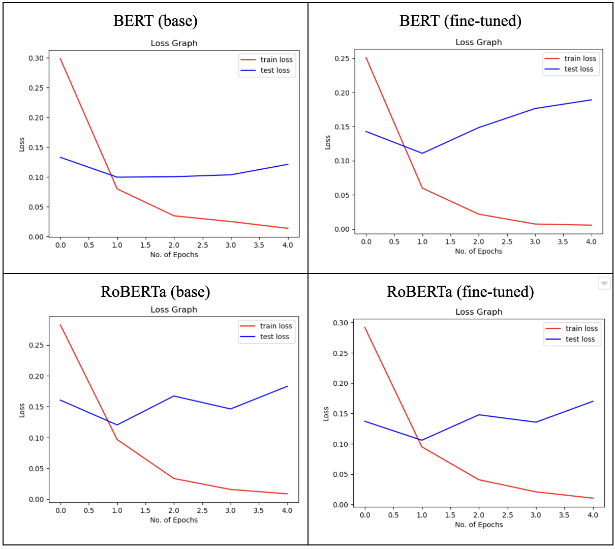
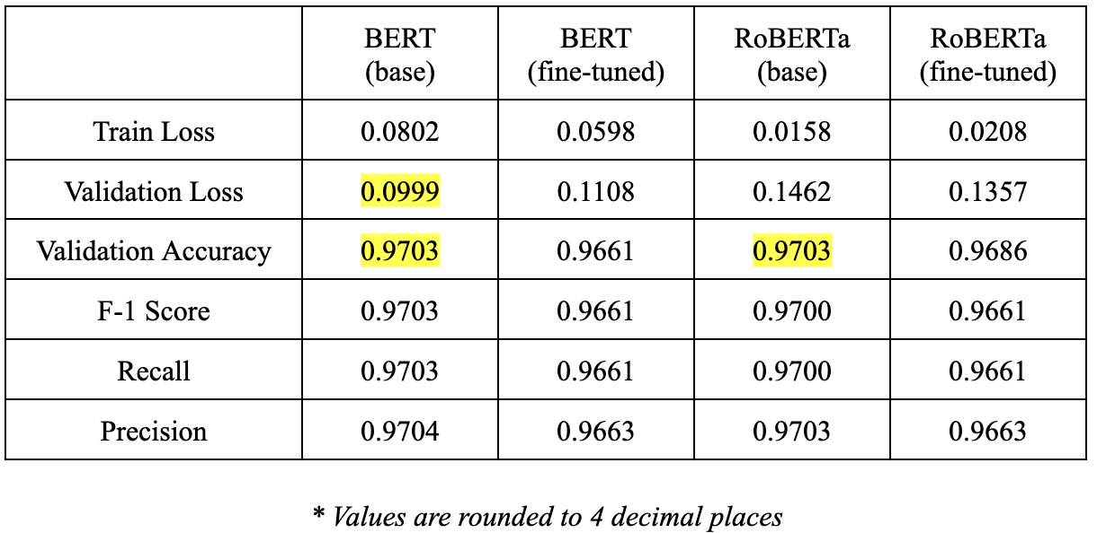
Classification Experiments
We experimented, trained and compared models with base against fine-tuned models - 5 epochs each.
Best Performing: BERT (base)

Slide 14
Clustering
04
Notes:
Aaron

Slide 15
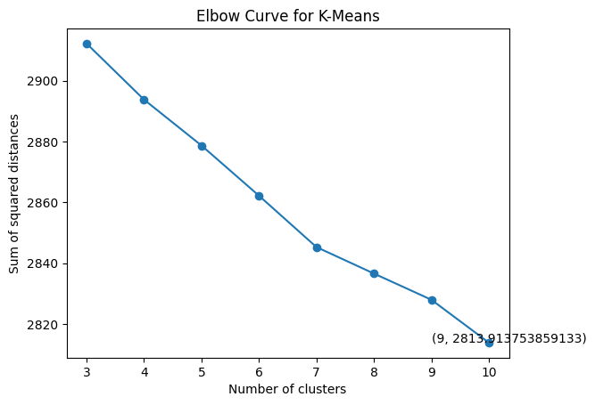
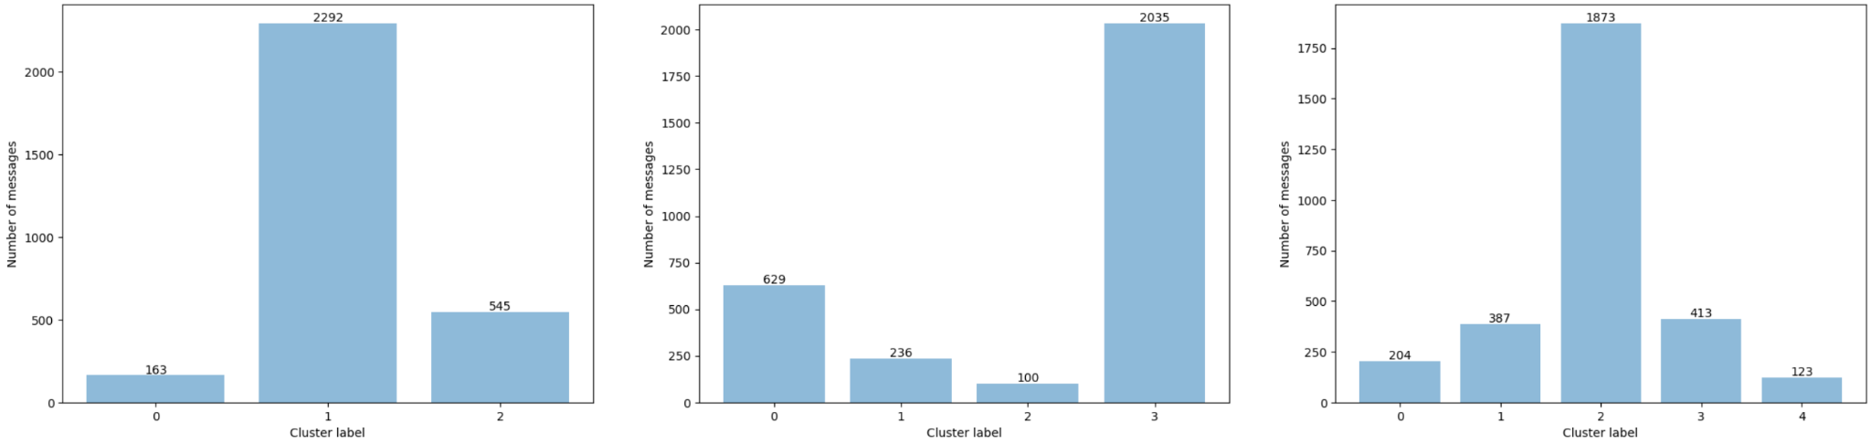
K-means Clustering
TFIDF
Elbow curve: optimal # clusters ∈ [3, 5]

Slide 16
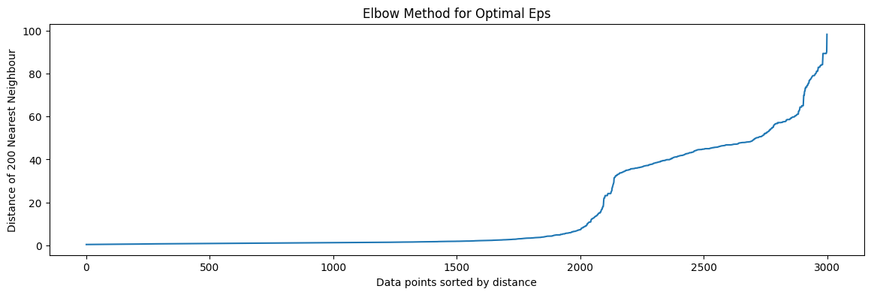
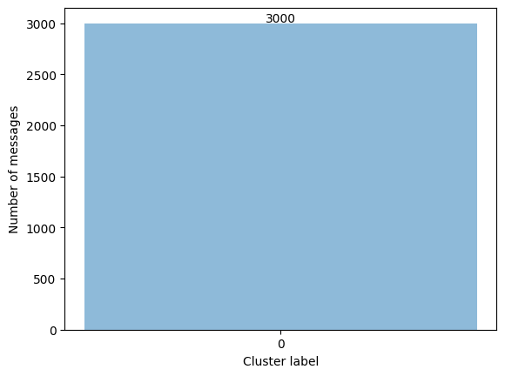
DBSCAN
Vectorizer: Word2Vec
MinPoints = 200
Elbow method: Eps = 40

Slide 17
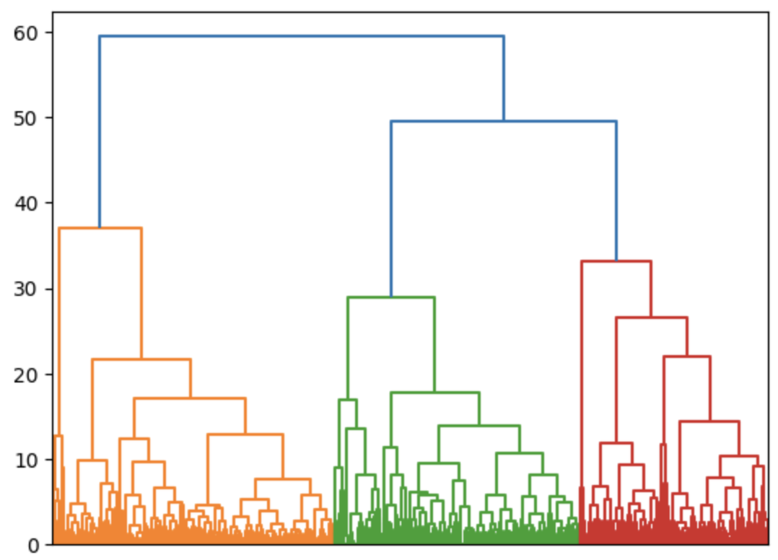
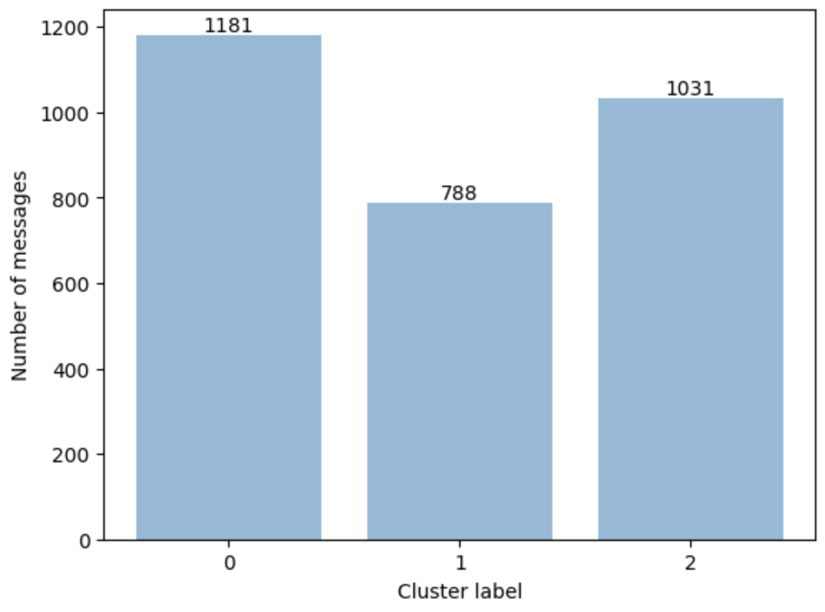
Hierarchical Clustering
Vectorizer: Word2Vec
Ward’s minimum variance method
Dendrogram: Distance between clusters → 3 clusters

Slide 18
Label Generation
05
Notes:
Aaron

Slide 19
Label Generation
Utilized generative models (GPT2 & GPT3.5) for label generation for each cluster
Why Generative Models?
Traditional methods (frequent words & word clouds) are cumbersome by manually reading and labeling clusters
Generative model helps to improve automation

Slide 20
Prompt
“ Given a cluster of strings that are similar to one another, please generate a label that accurately describes the common theme or topic of the strings. The label should be concise, descriptive, and informative. Please provide a label for the following cluster of strings: ”

Slide 21
GPT2
K-means Clustering
Number of clusters = 3
todays money 10 day call to date phone to day phone call call call call
Number of clusters = 4
The above list of clusters can also help to determine which words or sentences
Number of clusters = 5
clusters 1-4 are available in a single page format, with the
Limited max text length
Inaccurate interpretation
Continuation of writing
Text summarization

Slide 22
ChatGPT3.5
K-means Clustering
Hierarchical Clustering
Number of clusters = 3
Cluster 0: Prize/Winning Claims and Offers Cluster 1: Marketing Lists and Communication Cluster 2: Mobile Phone Promotions and Services
Number of clusters = 4
Cluster 0: Mobile phone promotions and services Cluster 1: Winning prizes and offers Cluster 2: Information, numbers, and codes Cluster 3: Email and online marketing and services
Number of clusters = 5
Cluster 0: Prize Claim and Winning Notification Cluster 1: Mobile Text and Tone Services Cluster 2: Email Marketing and Information Lists Cluster 3: Holiday and Travel Offers Cluster 4: Award and Complimentary Collection
Number of clusters = 3
Cluster 0: Business and Financial Information Cluster 1: Email Marketing and Communication Cluster 2: Sales and Promotions
Labels for K-means clustering (k=5) are the most accurate and intuitive

Slide 23
DEMO
06

Slide 24
Demo Video

Slide 25
Conclusion
Successfully integrated a spam classifier, clustering algorithm, and generative model to build an automated contextual spam categorization tool.
This tool takes an input, classifies it as either spam or ham, and if it is spam, categorizes it into the appropriate category.
Accuracy of over 62% on ‘YouTube comments’ dataset
Significant impact in reducing amount of spam content users come across, improving their experience and reducing the risk of phishing attacks.
Notes:
Harsh

Slide 26
THANK YOU

